Slide 1
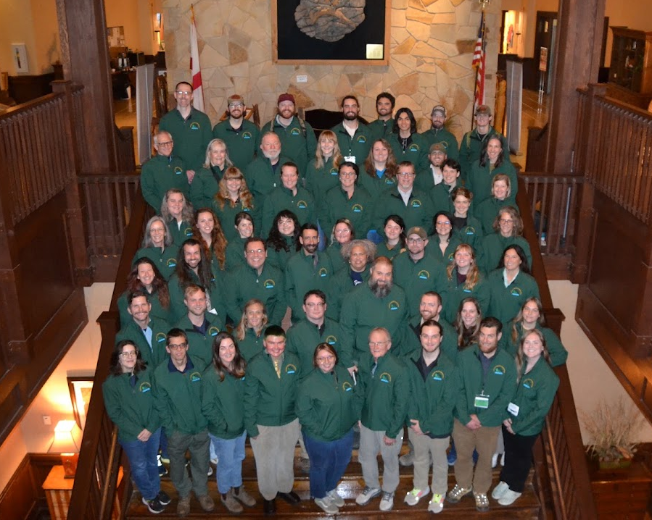

My Wild Spotter Experience
Cameron Bailey Oldham
Cultivated Areas Supervisor
Huntsville Botanical Garden
Huntsville, AL

Slide 2
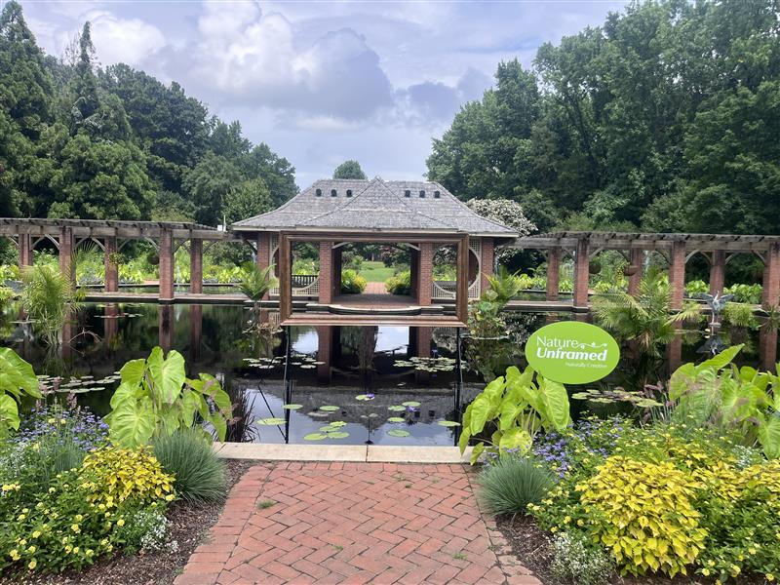
Agenda
How I found Wild Spotter
My experience with Wild Spotter
How I’ve implemented Wild Spotter at the Huntsville Botanical Garden

Slide 3

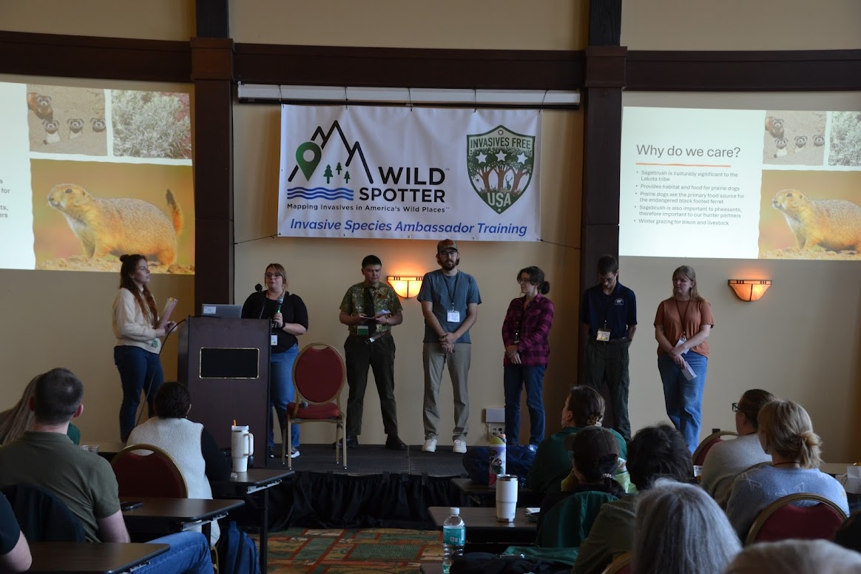
How I Found Wild Spotter
Received my Master’s in Conservation and Ecology from Middle Tennessee State University in 2023
  Deep desire to protect our natural world
  Love for educating others
Began as the Natural Areas Horticulturist at the Huntsville Botanical Garden in 2024
  Focus on invasive species education and removal
  Heavy emphasis on native plants
Attended the “Invasive Species Ambassador Training” in 2025
  Professional development opportunity through the HBG
  Found when searching for conferences that focus on monitoring and eradicating invasive species

Slide 4
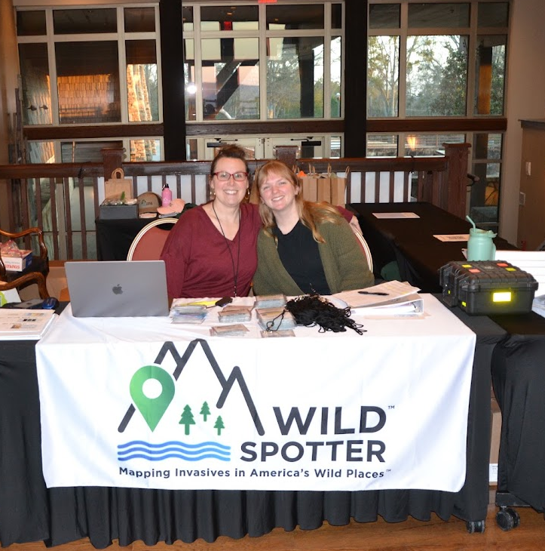
My Experience with Wild Spotter
My experience with the Invasive Species Ambassador Training
  Organization and content
  Hands-on training
  Diversity of speakers
  Recommending it to others
Working with Debby Monfort and Caroline Rae Shaw
  Technical knowledge
  Support after conference

Slide 5
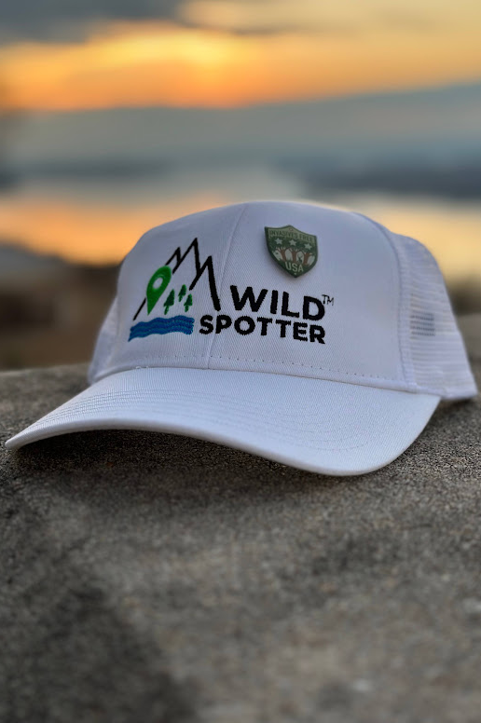
How I have Implemented Wild Spotter
“Invasive Species Spotlight”
  Done at our monthly department meetings
  Highlights an invasive species that may be flowering or about to come into season during that month
  Invasive Species Spotlight.pptx
Meetings with my Managers
  I have created a network of mangers at the HGB both within and outside of our Horticulture department
  I collaborate with them on ideas and advice for how to utilize Wild Spotter at work and in their personal lives
  I also made a PowerPoint explaining answers to the most common questions I get asked about Wild Spotter
  Wild Spotter.pdf
Collaboration with Education
  I am currently working with our Education Department to implement an invasive species education and removal program that utilizes Wild Spotter

Slide 6
Questions?
Cameron Bailey Oldham
Cultivated Areas Supervisor
Huntsville Botanical Garden
coldham@hsvbg.org

